Slide 1

Multilingual Sentiment Analyzer
Presented By - Gaurav Khanolkar

Slide 2
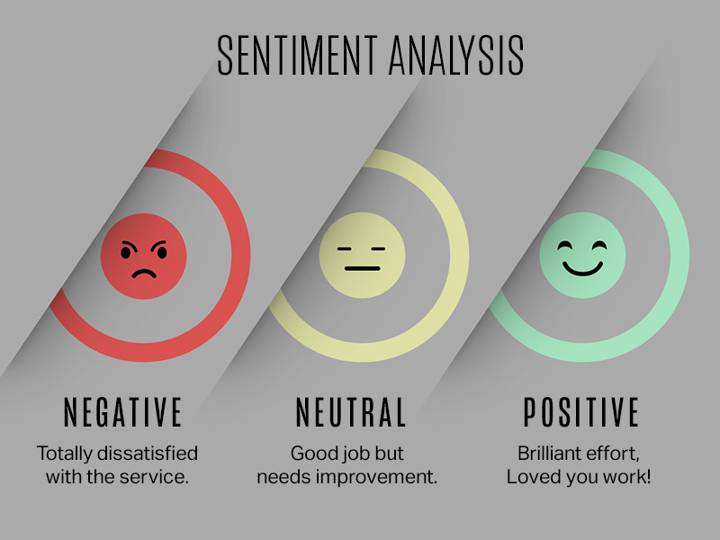

Slide 3

What is Sentiment Analysis?
The process of determining the emotional tone behind a piece of text.
Classifying opinions as positive, negative, or neutral.
Example: "This product is amazing!" (Positive), "The service was terrible." (Negative).

Slide 4
Why Multilingual Sentiment Analysis?
The world is not monolingual. Data exists in countless languages.
Businesses, organizations, and individuals need to understand sentiment from a global audience.
Access to broader insights, market trends, and customer feedback.
Breaking down language barriers for sentiment extraction.

Slide 5
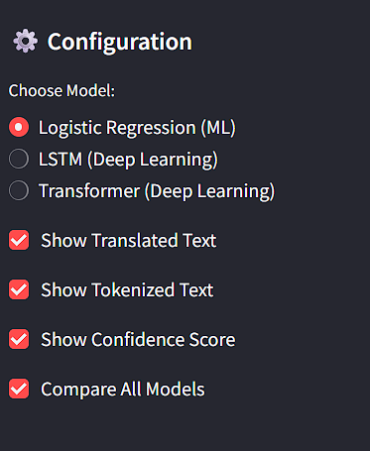
System Architecture Overview
User Input (Multilingual Text)
1. Language Identification Module
2. NLP Preprocessing Module:
Translation Engine to Text in Pivot Language
Tokenization
3. Sentiment Analysis Models:
ML (Logistic Regression):
For general sentiment classification.
DL (LSTM/Transformers):
For deeper, contextual analysis.
4. Sentiment Output:
Sentiment Label (Positive, Negative, Neutral)
Confidence Score

Slide 6
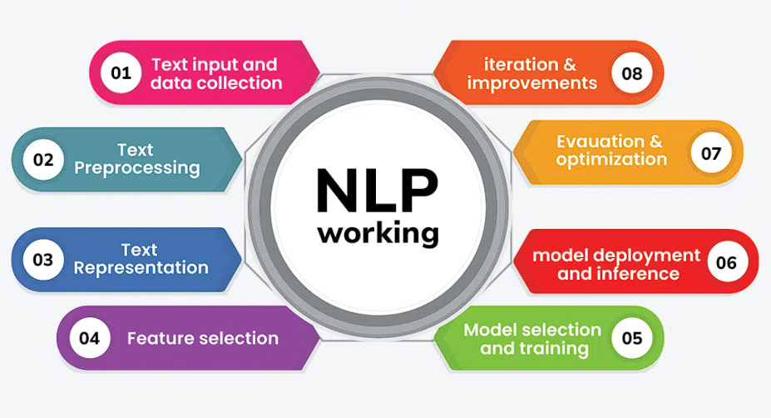
Role of Natural Language Processing
Language Identification: Automatically detect the source language of the text.
Language Translation:
Convert text from source language to a common pivot language (e.g., English) for unified sentiment analysis.

Slide 7
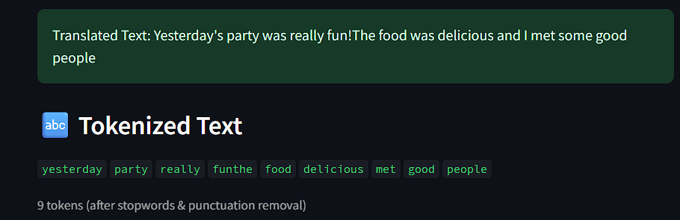
Tokenization:
Breaking down text into individual words or sub-word units (tokens).
It’s Importance: Crucial for feature extraction and model input.

Slide 8
Why Logistic Regression?
Simple, efficient, and interpretable.
Good baseline for binary or multi-class classification.
Probabilistic output (positive/negative probabilities).

Slide 9
Why Deep Learning?
Captures complex patterns and contextual information.
LSTM (Long Short-Term Memory Networks):
Excellent for sequential data like text. Captures the flow and context of words in a sentence.
Transformers:
Attention-based models that weigh the importance of different words in a sentence.
Parallelization, superior performance on many NLP tasks, ability to handle very long sequences.

Slide 10
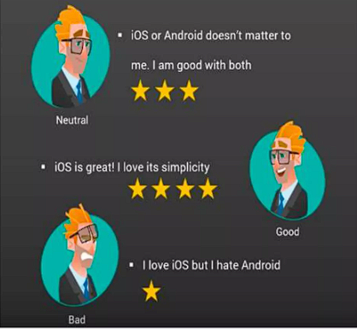
Applications
Customer Feedback Analysis: Understanding global customer reviews, social media comments, support tickets.
Market Research: Identifying sentiment towards products, brands, or events across different regions.
Social Media Monitoring: Tracking public opinion and sentiment in various languages during events or crises.

Slide 11
Conclusion
Multilingual Sentiment Analysis is a powerful tool for understanding global perspectives.
Combining NLP, ML, and DL enables robust and accurate cross-lingual sentiment extraction.
Unlocking insights from diverse linguistic data drives informed decision-making.

Slide 12


Slide 13


